Slide 1
Ethics of Leadership / Politics
The Complex Connections Between Ethics, Leadership And Politics
WEEK five LECTURES for PHI 300

Slide 2
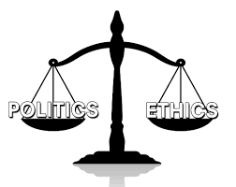
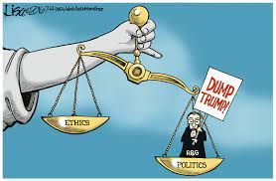
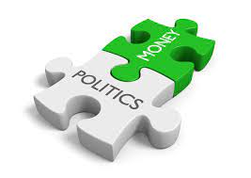
Background Thoughts about the Complexities Surrounding the Notions of Ethics, Leadership and Politics
Ethics and Politics are complex concepts, and there is a close relationship between them,
Ethics is a dimension that is inseparable from the daily life of men and women. This is clear if we examine its very etymology.
Both the Greek term ethos, from which ethics is derived, as well as the Latin term mos, the source of the word moral, refer to the same reality: the customs that are established in daily relations between the people of a community.

Slide 3
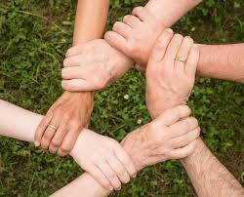
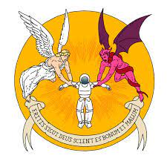
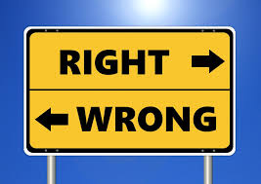
It is important to note that the moral or ethical dimension always pervades all human actions. This surprising phenomenon cannot be avoided.
All types of action and conviviality intrinsically carry with them a valuative connotation, the presence of values.
Values interpenetrate and possess us, it is values that always stimulate us to act. They are part of the very constitution of the human being.
it is impossible to think of or do something without being touched and incorporated by this ethical dimension: “we are ethical beings, ethics pervades our entire existence”. (Paulo, ^{Freire (1997)}

Slide 4
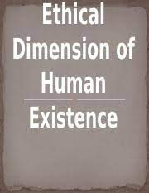
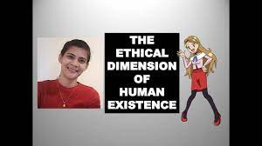
it is impossible to think of or do something without being touched and incorporated by this ethical dimension: “we are ethical beings, ethics pervades our entire existence”.
(Paulo, ^{Freire (1997)}

Slide 5
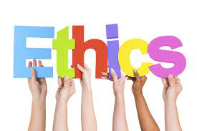
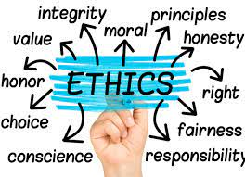
The idea of what's Good & What's Bad!
In everyday parlance it is commonly said - and this is not incorrect - that both ethics and morals are related to qualifications of good or bad.
This question, however, becomes intriguing, and much more complex, when we come to ask about the fundamentals of this “good/bad”.
It is at this point that some begin to distinguish between Ethics and Morals: Morals would be the customs and norms that are implicitly and tacitly established between peoples and groups, without questioning.
While Ethics would be a critical philosophical reflection about this crucial question: based on which we can affirm that something is good or bad.

Slide 6
The Main Ethical Theories at Play in these Complex Connections Between Ethics, Leadership & Politics
Naturalism,
Contractualism,
Consequentialism
Utilitarianism

Slide 7
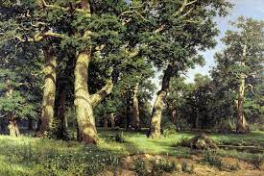
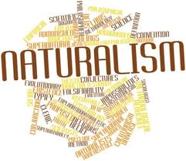
Naturalism
Ethical Naturalism, in ethics, the view that moral terms, concepts, or properties are ultimately definable in terms of facts about the natural world, including facts about human beings, human nature, and human societies
Hence, in Ethical oriented Naturalism, something is good or bad if it is adequate and responds to the laws of nature. Natural law is the great ethical law.

Slide 8
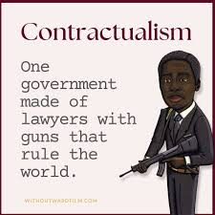
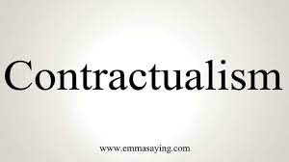
Contractualism
Contractualism appeals to the idea of a social contract. It attempts to derive the content of morality (and, in some versions, also the justification for holding that we are obligated to follow morality) from the notion of an agreement between all those in the moral domain.
Contractualism is an idea in philosophy. It is part of moral philosophy, which is ideas about right and wrong. There are two ways to think of contractualism: broad (general) and narrow (specific). Broadly, contractualism is the idea that morality comes from agreements between people.
While a second, contractualism, argues that what guarantees whether something is good or bad is positive law, which is created by humans: if there is law, it is presumed that it is good and must be followed.

Slide 9
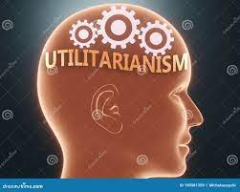
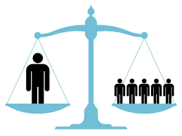
Utilitarianism
Utilitarianism is a theory of morality that advocates actions that foster happiness and oppose actions that cause unhappiness. Utilitarianism promotes "the greatest amount of good for the greatest number of people."
According to Jeremy Bentham's Theory of Legislation utilitarianism is an ethical foundation which determines that morality and legislation should be organised so as to provide the greatest happiness for the greatest number.
Jeremy Bentham (1748—1832) was the father of utilitarianism, a moral theory that argues that actions should be judged right or wrong to the extent they increase or decrease human well-being or 'utility'.
Mill's (1993: 7) utilitarianism is a system of ethics according to which 'actions are right in proportion as they tend to produce happiness, wrong as they tend to produce the reverse of happiness'. Mill believes that the pursuit of pleasure and avoidance of pain are the only motives in human behavior.

Slide 10
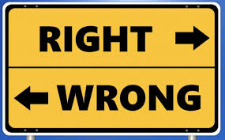
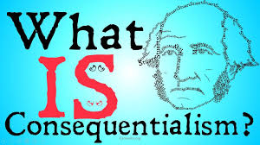
Consequentialism
In ethical philosophy, consequentialism is a class of normative, teleological ethical theories that holds that the consequences of one's conduct are the ultimate basis for judgment about the rightness or wrongness of that conduct.
Consequentialism is an ethical theory that judges whether or not something is right by what its consequences are. For instance, most people would agree that lying is wrong. But if telling a lie would help save a person's life, consequentialism says it's the right thing to do.
wrongness of actions – actions that seem to be immediately and intrinsically right or wrong. Consequentialists instead insist that moral rules, virtues, and our moral intuitions are justified when they promote good outcomes. For consequentialists, it is never wrong to do as much good as possible

Slide 11
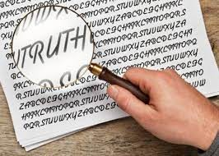
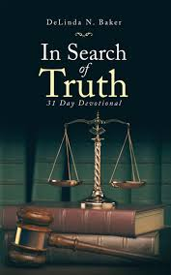
A Fact About Truth…
Truth is sought for its own sake. And those who are engaged upon the quest for anything for its own sake are not interested in other things.
Finding the truth is difficult, and the road to it is rough. Alhazen (Ibn Al-Haytham)
Critique of Ptolemy

Slide 12
Ethics, Leadership, Politics and Administration
Political ethics (sometimes called political morality or public ethics) is the practice of making moral judgments about political action, and the study of that practice.
As a field of study, it is divided into two branches, each with distinctive problems and with different though overlapping literatures. One branch, the ethics of process (or the ethics of office), focuses on public officials and the methods they use.
The other branch, the ethics of policy (or ethics and public policy) concentrates on judgments about policies and laws.
Both draw on moral and political philosophy, democratic theory and political science. But political ethics constitutes a free standing subject in its own right.

Slide 13
Political Ethics of Process
Political Ethics of Process:
The central question is the extent to which the ethical principles that govern political office differ from those that govern moral life more generally (Hampshire 1978; Thompson 1987).
To what extent are politicians permitted to take actions that would otherwise be wrong?
Ethics requires political leaders to avoid harming the innocent, but it may also obligate them to sacrifice innocent lives for the good of the nation.
A President may be morally obligated to order military action even while foreseeing that civilians will be killed. (The question of immoral means arises even if the war itself is just: See JUST WAR THEORY)

