Slide 1
Why Leadership is Essential
Leadership and Ethics

Slide 2
The Challenges Associated With Bad Leadership

Slide 3
They Celebrate Even When The Masses are Dying and Crying

Slide 4
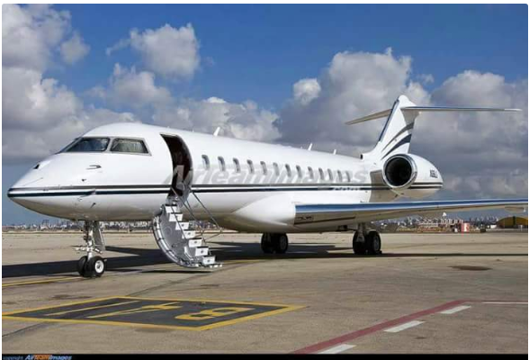
Sowore Accuses Tinubu Of Buying New $100m Presidential Jet Amid Economic Hardship
Sowore Accuses Tinubu Of Buying New $100m Presidential Jet Amid Economic Hardship
Activist and former presidential candidate, Omoyele Sowore, has alleged that President Bola Tinubu has purchased a $100 million presidential jet and further investing an additional $50 million for its customisation.
Sowore made the claim via his X handle (formerly Twitter) on Monday evening.
He went on to describe the aircraft: “The jet is an A330-200 initially christened VP-CAC and is now registered as 5N-FGA.”

Slide 5
The Origin of Leadership. (Gen. 1:28
Genesis 1: 28
The God Blessed them and said, Be fruitful and multiply.
Fill the earth and Govern it,
Reign over the Fish of the sea and govern it, the Birds of the Sky and all the animals that survey along the ground
Genesis 2;15
The Lord God Placed the Man in the Garden of Eden to tend and watch over it.

Slide 6
10 Reasons Why Leadership is Important
Leadership is the ability to guide and influence others.
What makes a leader a success or a failure?
What traits does a good leader need?
Can anyone become a leader?
These are questions researchers, business people, politicians, and countless others are always trying to answer.
Here in this presentation, we discuss some of the most pertinent 10 reasons why leadership is important:

Slide 7
#1. Good Leadership Ensures An Organization’s Identity Becomes Real
All organizations center on vision and values, which represent the organization’s identity.
Go to any “About Us” or “Mission Statement” page on an organization’s website and you’ll see. Turning identity into reality depends on good leadership.
Like a compass, leaders keep the organization pointed in the right direction. It can be easy to get off-track with distractions like everyday projects, shifting trends, and problem-solving,
but good leadership ensures an organization doesn’t lose its identity.

Slide 8
#2. Good Leadership Boosts Morale
Employees recognize poor leadership. They know when they aren’t respected or appreciated.
They also know when an organization doesn’t care about people and will cut corners for the sake of profit or power.
This affects morale and leads to less productivity, higher turnover, and a loss of faith.
Good leadership, on the other hand, respects and appreciates employees as valuable workers and as human beings.
Workplaces with high morale enjoy more productivity, happier employees, and less turnover.

Slide 9
#3. Good Leadership Inspire Others nspires
The ability to inspire is a key skill for a leader. Consider politicians.
The most successful and popular ones spend their campaigns talking to people, giving speeches, and inspiring communities to participate in the election process.
They understand what messages resonate and what values voters live by.
Politicians with leadership know how to unite groups and inspire action.
They don’t always use that power for positive ends, which is why inspiration is not the only trait good leaders have.

Slide 10
#4. Good Leadership Means Better Communication.
Good communication is one of the best skills anyone can have, no matter what environment they’re in.
It’s even more important for people in leadership. If they communicate something improperly, misunderstandings follow.
In a business setting, misunderstandings can confuse teams, derail projects, and even damage a business’ reputation.
Good leaders understand how essential communication is. They work hard to communicate clearly, clarify quickly, and set the appropriate tone.

Slide 11
#5. Good Leadership Fuels Innovation
Humans are an innovative species. Think of how far we’ve come from the days of stone tools or how fast technology like the internet has progressed.
What makes some people more innovative or creative than others is a complex topic, but emotional well-being, inspiration, and flexibility are part of the picture.
When people find themselves in an environment where they’re happy, inspired, and allowed flexibility, innovation follows.
A leader’s job is to create this kind of workplace.

Slide 12
#6. Different Leadership Styles Have Different Benefits (and Downsides).
When people think of “leadership,” many think of someone who takes a dominant tone and tells everyone what to do. That’s one style of management, but there are others.
Visionary leaders give employees creative freedom and always look to the future, but short-term goals can be affected.
Consultative leaders listen to all viewpoints before making a final decision, but balancing conflicting opinions can cause issues.
Participative leaders behave more as facilitators and involves everyone in decision-making, which is a democratic but long-winded process.
Leadership styles come with different benefits and downsides, so an organization should consider what makes the most sense and where the leaders’ strengths lie.

Slide 13
#7. Without Strong Leadership, Someone Else Steps In
Leadership matters because it always emerges one way or another. If it isn’t intentional or cohesive, disaster can follow.
As an example, let’s say the head of a business loves their work, but they don’t like taking a clear leadership role. They think it isn’t necessary because they trust their employees and everyone knows what and how to do their job. Instead of stepping up or delegating that responsibility, they do nothing. Soon, unofficial leaders emerge.
This example tells an important lesson: when there’s a leadership void in an organization, something or some one will fill it.

Slide 14
#8. Leadership Skills Are Beneficial Outside Work..
Leadership is often talked about in a business context, but the traits that make a good leader benefit every aspect of a person’s life.
Take integrity and good communication. When leaders have integrity, they earn the respect of everyone, including employees.
Outside the workplace, people with integrity are trustworthy, honest, and ethical.
We discussed how communication matters to a business, but good communication also improves a person’s personal life and relationships.

Slide 15
#9. Leadership Is Part of Personal Development.
You don’t need to be in a position of authority over others to hone your leadership skills.
Self-leadership is the ability to lead yourself in achieving your goals.
You’ll be more motivated, productive, and more likely to influence others.
Skills like self-awareness, self-regulation, and accountability reflect strong self-leadership. Empathy is also essential.
The best leaders aren’t cut off from emotions or relationships with others. They understand the importance of genuine connections.

Slide 16
#10. Leadership Can Mean Life or Death
The COVID-19 pandemic represents one of the most challenging times to be a leader. The stakes are high.
What does a good leader do in these times? In New Zealand, strict regulations have been in place since the pandemic’s beginning.
At the time of this article’s writing, 53 people in New Zealand died from COVID. The United States, which responded slowly and continues to leave most of the regulations up to the states, has lost over 900,000 people, putting it far above its peer nations.
In a 2020 article from Harvard Business Review, Michaela J. Kerissey and Amy C. Edmonson outlined four lessons for leaders in a crisis like COVID

