Slide 1
Special Lecture On
RESEARCH / PAPER/ SEMINAR WRITING
For
AUN STUDENTS
(Spring Semester 2024 – 2025)
Department of General Education Studies,
Faculty of Arts & Social Sciences (SAS),
American University of Nigeria (AUN),
Yola, Adamawa State…
WOGU, I. A. Power (PhD)
Identifying Research Problems/QUESTIONS & Developing viable research Objectives…

Slide 2
Outline of Lecturer/ Presentation
1. Introduction
2. Meaning and dimensions of a research problem
Research title or topic
Writing background to the study
Writing statement of the problem/Research questions
Significance
Scope and limitation
3. Aligning Research problem to objectives and hypothesis
4. Sources of research problem
5. Conclusion

Slide 3
Introduction Basic Research…
Research is a problem solving activity.
Essentially a Process & Journey of discovery.
Requires a sense of direction provided by a research problem and a destination specified by research objective(s).
Mapping the road and destination of a journey constitute the first part of the two parts of research.

Slide 4
Four Major Methods of Seeking Knowledge (Jones 1971)
Experience (Empiricism),
Reason (Rationalism),
Faith (Idealism),
Science (Scientific Method),

Slide 5
Three Kinds of Reasoning Applied when Acquiring Knowledge….
1. Deductive Reasoning (Deduction)
2. Inductive Reasoning (Induction)
3. A Combination of the Deductive & Inductive Methods of Reasoning (Cohen & Manion 1980:13)

Slide 6
Two parts of Research Project
Research is categorised into two activities:
(1) identifying and formulating the research problem, and,
(2) implementing the research.
The first has to do with most of what a researcher does in what is generally described as proposal.
The second part is the actual implementation, which entails data collection, presentation and analysis.

Slide 7
The First Part of a Research
Identifying a suitable title, Writing a clear Background Statement to the research and the Problem formulation & development of objectives broadly consists of the first three chapters in most conventional format of writing or conducting research.
That is, introduction, literature review and method of study
If a research problem is properly identified and formulated,
it should be expressed in a researchable topic or title;
Thrown up in the background to the study and eventually, Defined in the statement of the problem and research questions,
Shown to be important in significance of the problem

Slide 8
Choosing a Title or Research Topic
A research topic is a subject or issue that a researcher is interested in when conducting research.
Two problems face a researcher in this regard – either too many issues or ideas to research or no idea at all.
We deal with the first here – choosing right. Consider!
Interest of the researcher: Motivation, skills and relevance to field
Research-ablity: amenable to data collection;
Social researchers ask two fundamental types of questions: a) what is going on (descriptive research)? (b) why is it going on (explanatory research)?
Avoid ‘ought’ questions or value-laden questions
Manageable: feasibility, capability, handy
Significance: - Is the effort worth the while; contribution

Slide 9
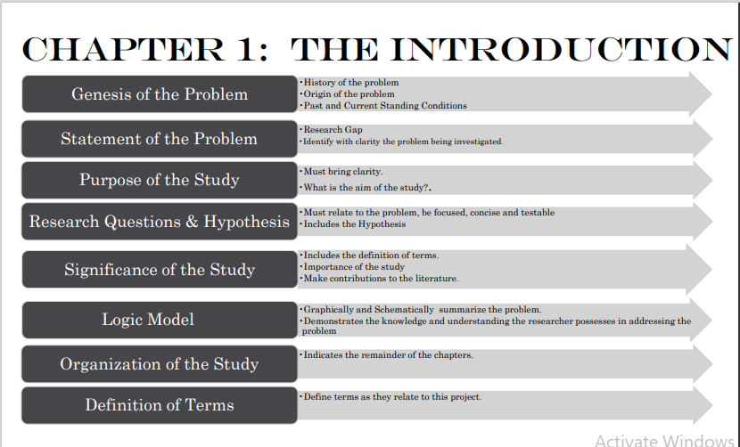

Slide 10
Table of Content of Most Regular Research
An introduction is defined as a beginning section which states the purpose and goals in an essay, article, or book.uctory chapter of research usually contains:
The research title or topic
Background to the study
Statement of the problem/Research questions
Objective
Significance
Scope and limitation.
In some format, even the hypothesis and the method of study are often included in the section.

Slide 11
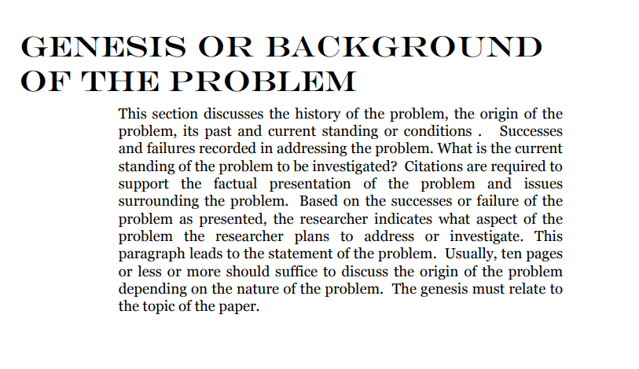

Slide 12
Writing the Background to The Study or Contextual Issues
Not about concept definitions, although there should be effort to highlight the meaning of key concepts of the research
Essentially about introducing the scholarly debate surrounding the research problem.
Showcases the root, nature, scope of the problem
Shows the extent previous studies have been successfully, underscore gaps, which current effort wants to address.
Highlights bad situation, unresolved scholarly contention, unacceptable position etc. that warrants the researcher’s attention.
Chronicles issue(s) that aroused the researcher’s interest

Slide 13
Sample Procedure for Writing a Background to the Study
Step 1: Worldview background issues to the study
Step 2: Regional view to the background study
Step 3: National view to the background study
Step 4: Local view issue to the background study
Step 5: Research Intuition (Lango, 2020:2)
Let it also be said that all these sections do not warrant pages and pages. Background to the study is part of the introduction to the research. Issues raised in the introduction of any writing are not details but highlights of what is to come. Conceptualisations, any scholarly debate, global situation, regional, and even national situations, will all be addressed in more details to show theoretical and empirical status of the extant literature and the gap being created.
It is therefore important to say that the background should be concise and focused on important issues that help to justify the worth of the study. Some of these issues could take just a paragraph or two to address.

Slide 14
Statement of The Problem
Is a sentence or two that clearly proposes what the researcher wants to examine, investigate, describe, interrogate or any of such words that explain the research project.
Students get carried away by the preamble to introduce the research problem
Usually fail to clearly state the problem
It can come at the beginning of the section with such phrases like: This study investigates, examines, interrogates etc.
Or at the end with such conjunction like, ‘it is against this backdrop that this study…...
Students must be able to distinguish the problem that led to a research and the research problem itself
Students often repeat the same information in the background to the study in their statement of problem

Slide 15
Statement of Problem…
Liken the relationship of background to problem of research to that of symptoms and the sickness.
“The researcher [should] delineate the actual research problem from symptoms. Think of the diagnosis process that patients who visit doctors go through. The doctor asks a number of questions that enable the patient to describe the symptoms of a disease so that the doctor can know what the problem is.
The intention of the doctor is to treat the problem and not the symptoms. This is also what is expected in managerial action or research situations: the manager or researcher is expected to find a solution to a problem and not for the symptoms of the problem. “(Muganda, 2019).

Slide 16


Slide 17
A Typology of Statement of The Problem
Despite the apparent failure of local governments to deliver basic services in Nigeria and Admawa state in particular, few local governments have consistently made a difference in service delivery. Scholars have shown that capacity to generate own resources could make a difference in ability of LGs to provide services. Although a large chunk of revenue of LGs come from intergovernmental fiscal relations which the states usually managed to their advantages and disfavour of the LGs, it is suspected that the ability to generate internal revenue could make a difference in the resources available to local governments to provide services to their citizens. This study thus seeks to interrogate conditions that could enhance the capacity of local governments in service delivery despite obvious challenges of poor state-local fiscal relations.

Slide 18
BROAD CONCEPTION OF RESEARCH PROBLEM IDENTIFICATION
Demarcated and delimited in the scope and limitations
Conceptually answered or solved in the propositions (hypotheses)
Linked to the gap exposed in the literature, which helps to pinpoint the importance and contribution of the research; and,
Be amendable to the method through which appropriate data will be collected.
I have not taken this broad approach here
Mainly focused on the features of the introduction chapter…

Slide 19
Research Question(s)
Questions are primary means of dealing with the unknown and of obtaining new information (Yeager, 2008).
Research question is the focal question a research project is intended to answer/address.
It is intrinsically connected to a research problem and should make it more specific and obvious .
It should further simplify the topic and the research problem to show the questions that need to be answered in the research
If we take the Statement of a Research Problem to be generalized, research questions are meant to break it into specifics and identifiable variables. Consider the title:
Voice, responsiveness, and alternative policy venues: An analysis of citizen complaints against the local government to the national Ombudsman.

Slide 20
Research Questions….
The relationships of these concepts are not clear in the title.
The problem statement clearly defines:
“This article relies on classic arguments from public administration and public policy, including the exit-voice-loyalty (EVL) framework, to develop such an explanation and analyze the role of the national Ombudsman as a voice solution of last resort for citizen dissatisfaction with their local governments”

Slide 21
Research Questions….
Observe that the passage above has no explicit research question
But from the problem statement,
The national Ombudsman is the independent variable that should influence voice to citizen’s dissatisfaction.
The case study or context is local government.
Another point here is that Research question may be explicit or implicit.
It is implicit when question is not stated,
Many research articles do not have an explicitly stated research question.
As students, however, you are encouraged to clearly state this as a learning and internalisation process.

Slide 22
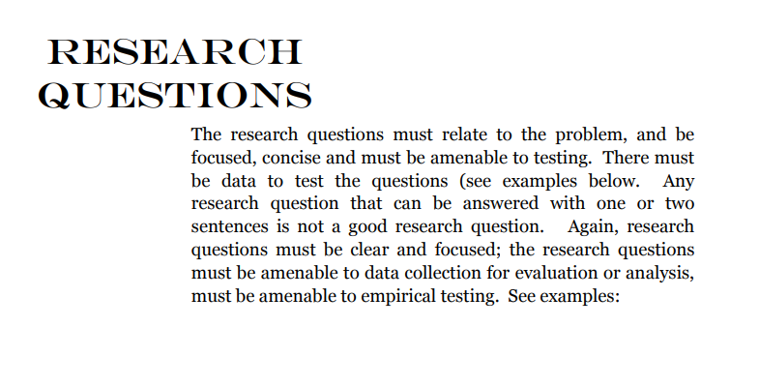

Slide 23
Kinds of Research Questions
A descriptive research problem/question
Difference research problem/question
Relational research problem/question
Causal research question – this is more demanding
Asking cause and effect question may require a whole lot of controls to ensure that there are no extraneous causal factor or other intervening variables apart from the one being measured.
Although we often use effect to relate variables, it must be noted that proving causal relationship is difficult in social science.

Slide 24
CHARACTERISTICS OF A GOOD RESEARCH QUESTION
Highlights a genuine dilemma, area of ambiguity, or point of confusion about a topic
Yields an answer that is unexpected and not obvious rather than inevitable and self-evident;
Provokes meaningful thought or discussion;
Raises the visibility of the key ideas or concepts that may be understudied or hidden;
Suggests the need for complex analysis or argument rather than a basic description or summary; and,
Offers a specific path of inquiry that avoids eliciting generalizations about the problem.
See full paper for samples…

Slide 25


Slide 26
ALIGNING RESEARCH PROBLEM TO OBJECTIVE AND HYPOTHESIS
Developing research objective is a significant part of an introduction or identification and formulation of the research problem.
Synonyms: aim, object, target, goal, end, or ultimate reason for carrying out research in the first place.
If conducting a research is a journey, the objective defines the destination
A research objective is simply defined as the state of affairs that a research is intended to achieve and that (when achieved) terminates behaviour intended to achieve it; “
It is the goal a researcher sets for his or herself in relation to the research question/problem.
Research objective should be definitive
Not be too ambitious.
Every set objective should be exhaustively attended to.
Setting too many objectives for a single piece of research or a difficult objective will surely lead to inability to attend to them comprehensively.

Slide 27
How to Develop and Write Good Research Aims and Objectives
objectives do not normally spring forth fully formed in a sudden eureka moment.
They tend to emerge slowly, after considerable thought, and time taken to develop and finalize it
In designing a project, give yourself plenty of time to think through your aims and objectives.
Read around your subject.
Look at how other researchers frame their aims and objectives.
Frame and draft your own research objectives.
Write them down and ask other people to comment on them.
Revise it until you are satisfied with it as an opening or provisional attempt to describe your goals.
Show it to colleagues, supervisors, friends and family.
Do they understand what you mean? Do they agree with the particular objectives you have chosen? Do they regard them as feasible?
Use all the feedback to assess clarity, relevance, logical consistency and practicality of your research objectives

Slide 28
SOURCESES OF IDENTIFYING RESEARCH PROBLEMS, RESEARCH QUESTIONS AND OBJECTIVES..
What are the sources for identifying research problem whether in terms of topic, problem statement, research question or objective?
Knowledge of one’s field, innovation, or creativity, and efforts to develop theory and apply it (Tullock, 966)
Social scientists are in the business of describing and understanding the world around them
They defining what it is,
how things work, and
how to improve them.
Mental examination of these things can throw up a thousand and one things that need to be explored, described, explained or predicted
Let’s even start with the fundamental administrative principles- POSCORB

Slide 29
SOURCES OF RESEARCH PROBLEM, RESEARCH QUESTIONS AND OBJECTIVES
Research problems and questions come from practice and theory
Structure, rules and processes of government.
Curiosity about what practitioners do; why do they do it; how they can do it more effectively and efficiently.
Curiosity/disagreement with scholarly positions can be gleaned from the literature.
Research problems can come from classroom discussions and assignments,
It can come from the life experience of the researcher
Conference themes and sub-themes
Discussion with peers
Listening to experts and public commentators in the media
Social media reporting.
There are enough troubles and problems in every sphere of human endeavour.
Only uncritical mind fail to see problems and difficulties that need academic research to find answers.

Slide 30
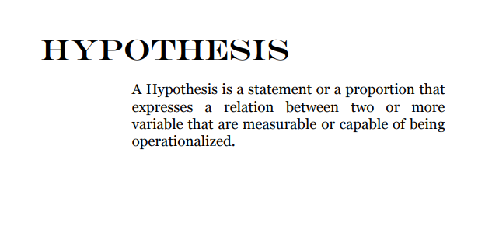

Slide 31
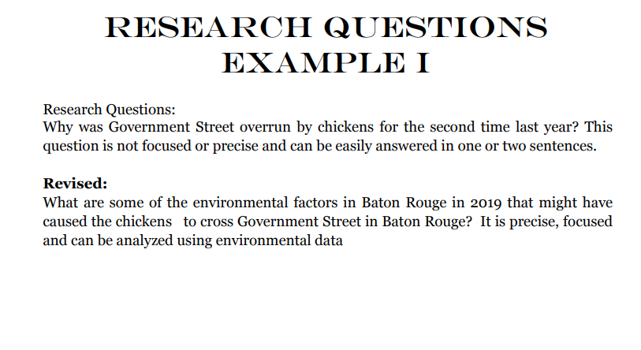

Slide 32
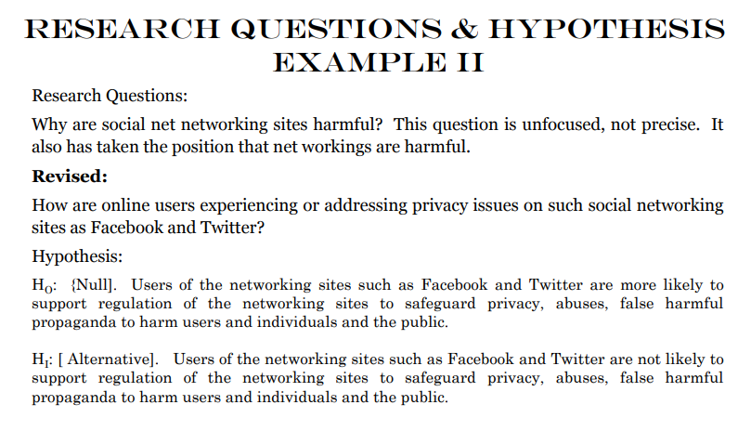

Slide 33
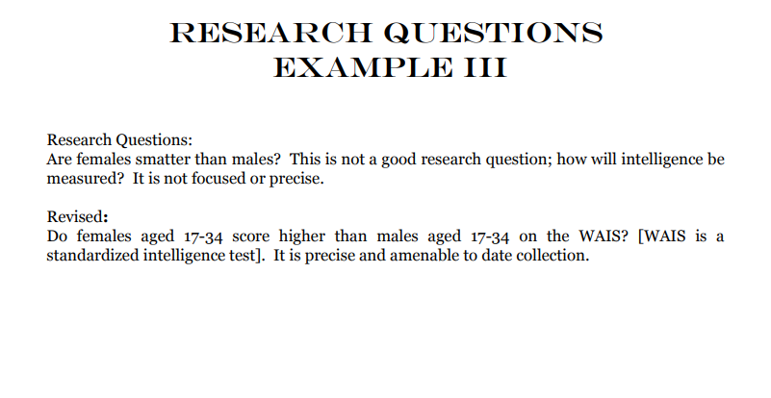

Slide 34
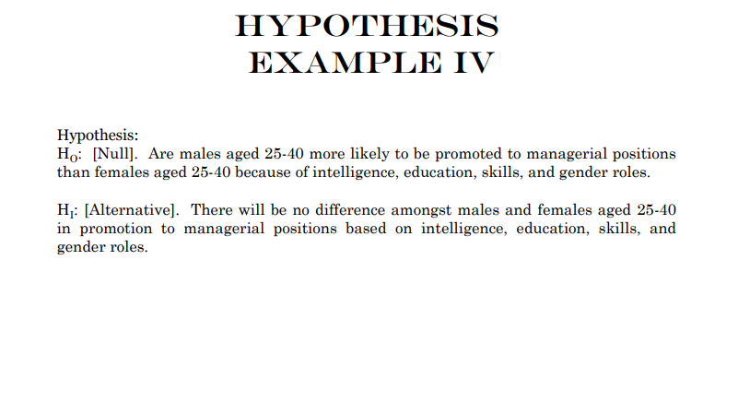

Slide 35
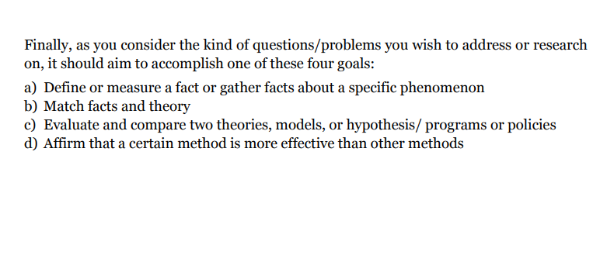

Slide 36
Significance of The Study….
Significance should be logically linked to the gap, the problem of study and objective
It is less important to say who benefits than the ‘how’
Addressing the how is essentially the justification
It is pure mundane to list beneficiaries like students, researchers, policy makers as beneficiaries without the :how”
And this “how” should be circumspect and related to the study outcome.

Slide 37
Sample Significance of Study
Development of a Source Material in Food Dehydration Craft Technology for the Secondary Schools” by Mary Rose Florence S. Cobar.
The study of dehydration technology and fabrication can be a learning paradigm in the secondary level and vocational schools to enhance the students’ knowledge and entrepreneurial skills as well. The project’s goal is designed to help students improve academic competence, develop employability skills, implement a career plan and participate in a career pathway in preparation for post secondary education or careers in the food manufacturing or services sector after graduating from high school.
Bureaucratic Politics and the Implementation of Liberalization Reforms in Nigeria: A Study of the Unbundling and Reorganization of the Nigerian National Petroleum Corporation
… it is striking to observe that very little attention has been devoted to understanding how the interests of bureaucratic agencies play out in policy implementation in less developed countries, particularly in Sub-Saharan Africa, where most decided policies are poorly implemented, or not implemented at all. The study aims to expand the scope of application of the bureaucratic politics model in understanding policy outcomes. It also contributes to the literature on policy implementation research, and to inter-agency relationships and interests in a developing country environment

Slide 38


Slide 39
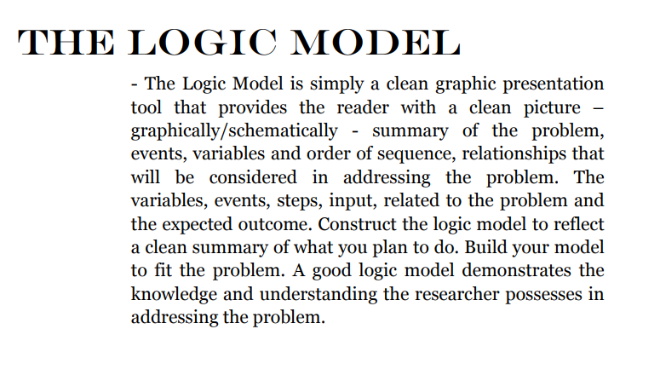

Slide 40
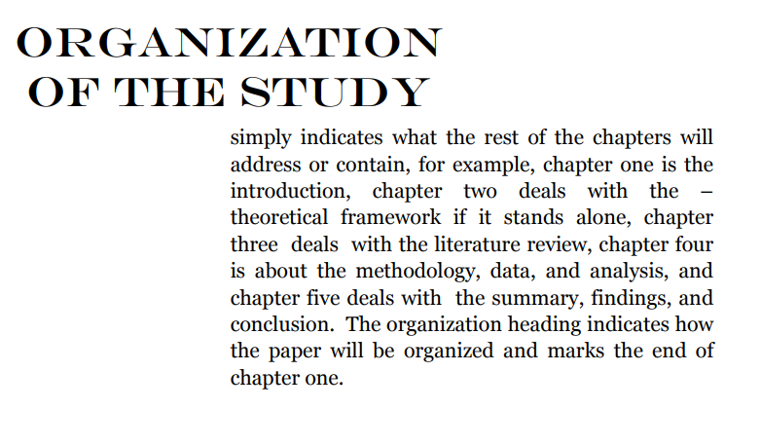

Slide 41
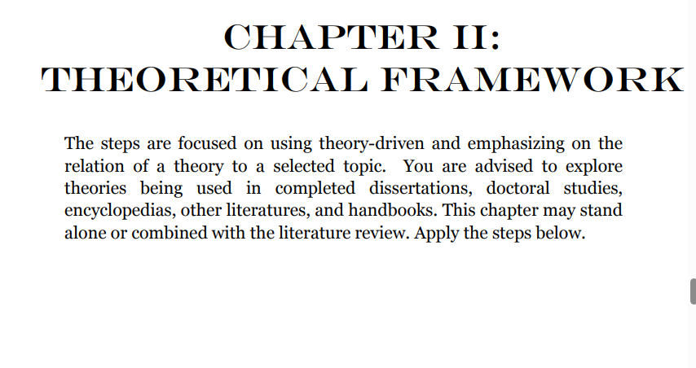

Slide 42
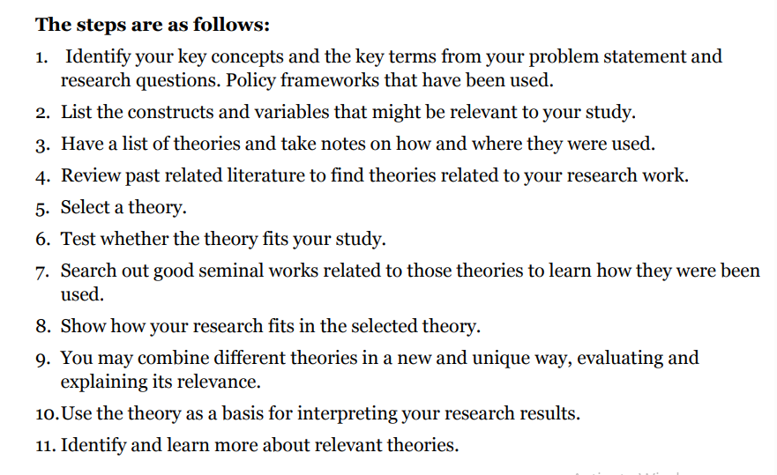

Slide 43


Slide 44
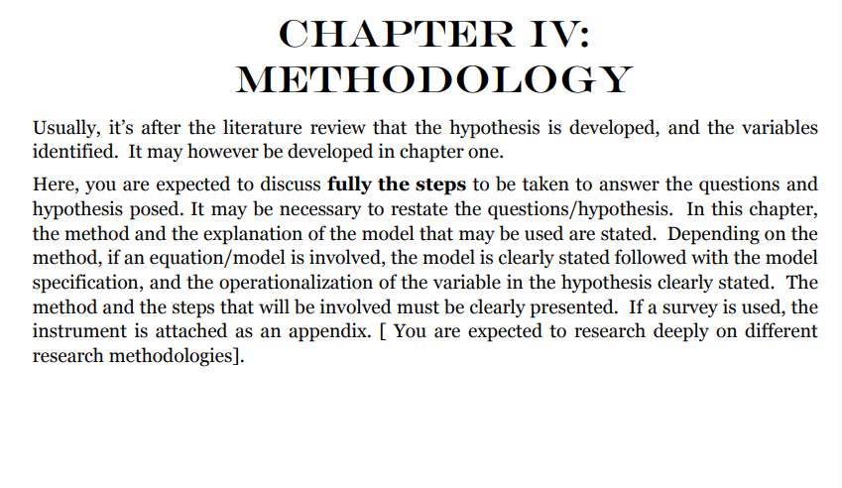

Slide 45
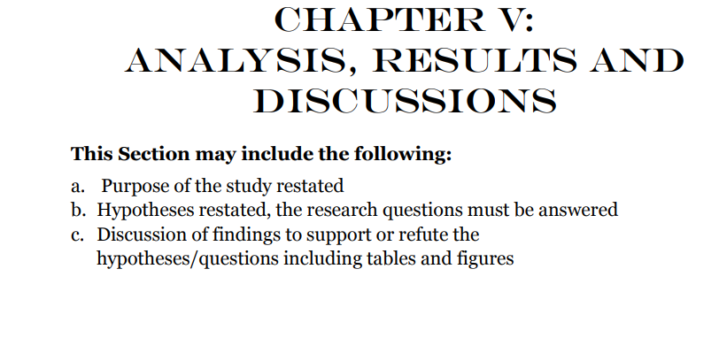

Slide 46
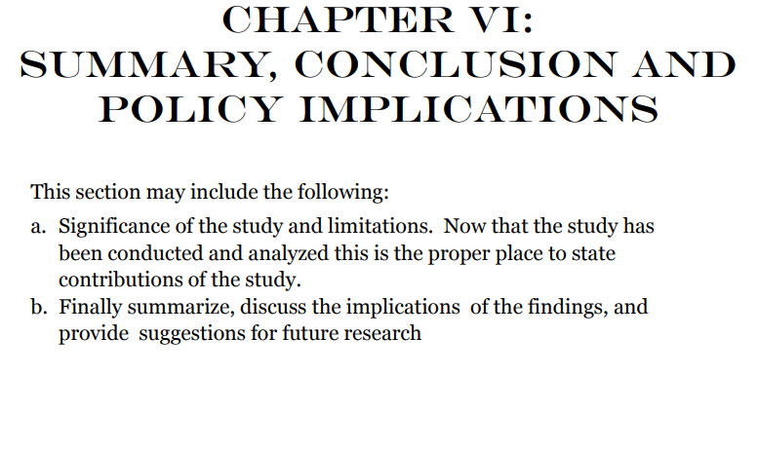

Slide 47
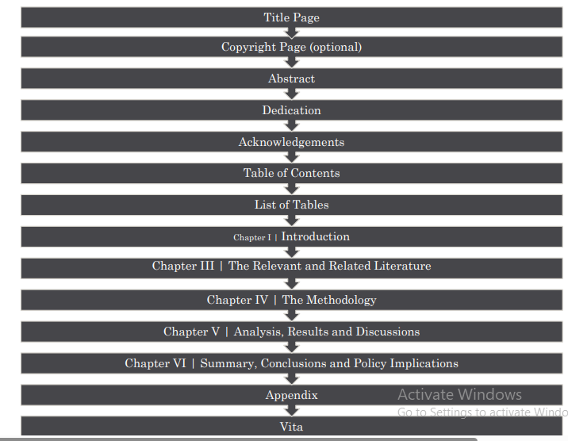

Slide 48
Conclusion
WE DIVIDED RESEARCH PROJECT INTO TWO BROAD PARTS –
identifying and formulating the problem and setting objectives, and,
The actual execution of what has been planned.
The first part is explained as mapping out the destination and road to a journey
It is the most critical aspect of a research.
If properly done, should put to rest other decisions that need to be taken to accomplish a research project - literature review, methodology, data collection and analysis.

Slide 49
ONE FINAL THING I NEED TO SAY…
There are two types of research in a research project that must go together:
1) Research on how to write a research report, and
2) The actual research you wish to do
Students should have and consult good research texts as they write their research project
No subsection (e.g. background to the study) should be written without conviction about what should come under it.
Many just set off writing whatever comes into their head.
This is prevalent under background, statement of problem and of course literature review.
Research is scientific, and there is expectations from each subsection of your research work.
Again logic or sequence is very important.

Slide 50
Thank you…

Slide 51


