Slide 1

Theories of Leadership

Slide 2
Leadership Theories…
1. Strong moral principles and ethics
2. Excellent organizational abilities
3. Competent learner
4. Encourages employee development
5. Encourages affiliation and connection
Theories of leadership explain how and why specific individuals become leaders.
They emphasize the character, characteristics and actions that people might adopt to improve their leadership skills.
Some of the top qualities cited by leaders as essential to effective leadership include:

Slide 3

These qualities are thought to be the most crucial by leaders all across the world, according to research.
And leadership theories aid in illuminating how leaders use and cultivate these qualities.
Leadership theories have recently been more codified, which makes them simpler to comprehend, discuss, and evaluate in practice.

Slide 4
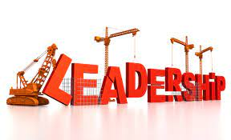

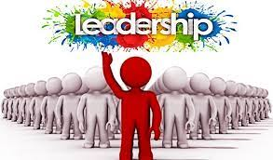
What is a Leadership Theory / What is the Essence of the Study of Leadership Theories
A leadership theory describes how and why certain individuals become leaders.
The focus is on the characteristics and behaviors that people can adopt to enhance their leadership ability.
According to leaders, strong ethics and high moral standards are essential qualities of a good leader.

Slide 5
What Makes An Honest Leader?
A successful leader possesses personality, bravery, a transparent vision, and ambition.
A strong leader creates organizational success by encouraging the team to perform at their highest level.
ESSENTIAL LEADERSHIP SKILLS OF EXCELLENT LEADERS.
1. UNDERSTAND THE WAY TO OFFER SUPPORT. Supportive leaders are accessible to their staff, transparent about their choices, team players, and adept communicators of plans and tactics.
HAVE EMPATHY AND DEMONSTRATE IT
KEEP THE LINES OF COMMUNICATION OPEN
BEING CAPABLE OF TAKING DECISIONS
EFFECTIVE PLANNING
COLLABORATE.

Slide 6
SOME OF THE MOST NOTABLE LEADERSHIP THEORIES KNOWN TODAY…
1. The Great Man Theory,
2. The Trait Theory, and
3. The behavioral Role Theory
4. The Transactional Theory or Management Theory,
5. Theory of Transformation.
6. The Theory of Contingencies,
7. The Theory of Situations
8. Behaviorist Theory,
9. Behavioral Theory
10. Functional Theory,
11. Integrated Psychological Theory.

Slide 7

The Great Man Theory…
The Great Man Theory:
One of the first theories on leadership makes the assumption that these qualities are inherent, which indicates that leaders are born, not created, and cannot be learned.
This hypothesis asserts that a leader has certain innate human characteristics, such as:

Slide 8
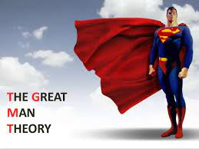
Great Man Continued…
THESE INNERT QUALITIESINLCUDE:
1. Glamour
2. Decisive
3. Wisdom
4. Daring
5. Assertiveness
6. Appeal

Slide 9
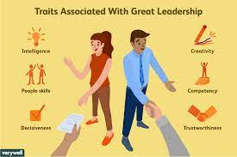
The Trait Theory…
The great man theory is expanded upon by the trait theory of leadership, which is predicated on the idea that effective leaders have particular personality qualities and features of behavior.
They can become effective leaders in a number of circumstances thanks to these qualities.
It also promotes the idea that certain people are more naturally gifted as leaders than others.
Effective people have hobbies and personality traits that are very different from those of Non-leaders.

Slide 10
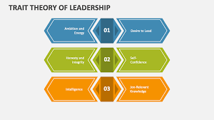
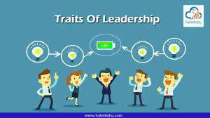
THE MAIN CHARACTERISTICS OF A SUCCESSFUL LEADER ARE:
Emotional equilibrium
Acknowledging one's duty
Competence
Recognising obstacles
Thinking with action
Motivational abilities
Talents in communication
Tenacity and flexibility
Making decisions with assurance

Slide 11
The Behavioral Role Theory
This theory largely says that people define roles for themselves and others based on social learning and reading,
form expectations about the roles that they and others will play, Hence, the subtly encourage others to act within the role expectations they have for them, and act within the roles they adopt.
This theory explains behavior based leadership. The best way to lead people is understanding people
This theory states that a good leader is aware of him/herself and the people around them. They take social cues and signals from the environment about their role in any situation and behave accordingly.

Slide 12
The Fact about All These Theories of Leadership
All of these theories explain leadership in its complexity, but the truth is that good leaders embody all of the theories.
A person can be born into any leadership to situation, but if they do not have well developed traits and skills, they will not be effective.
Similarly, a person can have excellent traits and skills, but if they can not manifested where they are needed in a situation, then their traits and skills will fall short of what is needed.
All of these theories and many others combine to form what builds a good leader.

