Slide 1
General Introductions to AUN 300 (Critical Thinking and Problem Solving Skills) @ AUN, September, 2024
Course Lecturer: WOGU, I. A. Power (PhD)
Department: General Studies Program
School of Arts & Sciences,
American University of Nigeria

Slide 2
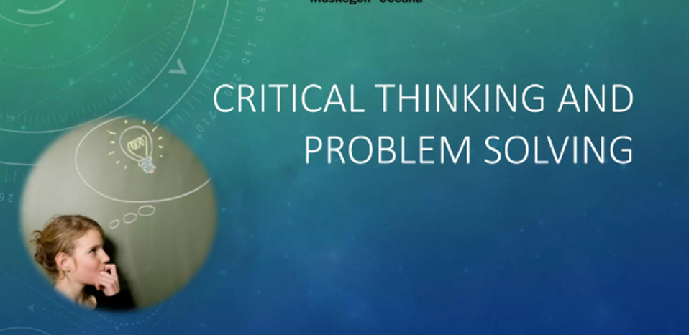

Slide 3
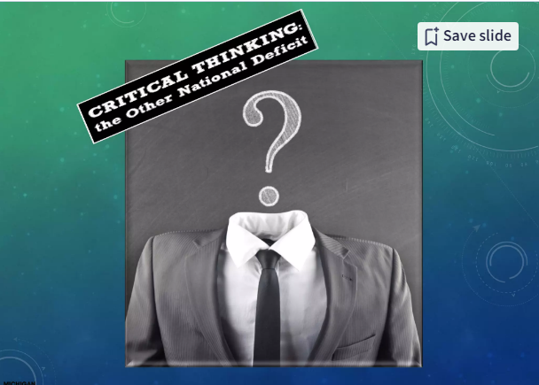

Slide 4
There is a high rate of dearth of Reasoning and critical thinking for problem solving amongst Men today
Come now, and let us reason together, saith the LORD: though your sins be as scarlet, they shall be as white as snow; though they be red like crimson, they shall be as wool.
ISAIAH 1:18

Slide 5
Why should we pay close attention to the study of Critical thinking and Problem Solving @ AUN???
Not more than 5% of people in the world actually make use of their brains to think critically and reason.
About 15% of the entire population goes around with the notions and feeling that they are actually thinking critically or reasoning while they are not.
The reaming 80% percent would rather not have anything to do with the act of thinking Critically or reasoning. This greater majority believes they can do without the trouble of thinking Critically and reasoning.
Can you figure out the percentage that Nigeria and AUN Students occupies in the above dater?

Slide 6
Aims & Objectives of the lecture On Critical Thinking & Problem Solving
The main aim and objectives of the lectures on Critical thinking & Problem solving, among other things, is to aid the mind in arriving at the knowledge of the truth.
We need to also state here that appeal to common sense alone may not be enough. The relations must be formulated in rules by which a prudent person can regulate or order actions and things.
To put it simply, true knowledge in terms of a proper arrangement, ordering and utilizing of the materials of thought is an important aim of Critical thinking and Logic.

Slide 7
The Relevance Of Critical Thinking And Problem Solving as a Course To AUN Students & Nation Building.
Critical thinking & Problem Solving helps to implant consistency both in speaking and in writing.
Critical thinking & Problem Solving helps not only to bring order to thought, but also to speech and writing in order to gain clarity, precession and firmness.
The lack of Critical thinking & Problem Solving skills in this time and age often results to vagueness, feebleness, tautology, errors in reasoning and wooliness of expression, etc.
Critical thinking & Problem Solving touched every other discipline, it does not only deals specifically with the special methods and rules of procedures of other sciences, but also,
Its practice brings to light those very general laws and canons to which reason must conform to, while laying down principles for the unification and the classification of all other sciences..

Slide 8
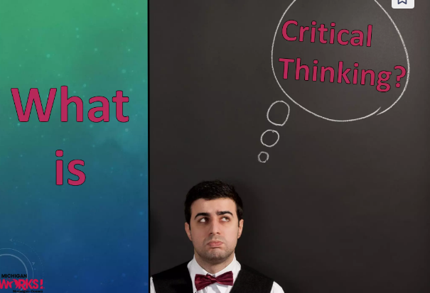

Slide 9
FOUNDATION OF THINK
ING CRITI
CALLY
???
Corgito Ergo Sum, “I think Therefore I am”
One of Descartes life long quest was to identify certainty.
To be able to achieve this task, he saw the need to do what he called philosophical Bracketing”
Doing this meant being willing putting away all the things he previously knew and considered as true about the knowledge and foundation of the world.
To be able to arrive at a knowledge that superseded already existing knowledge, there was therefore the need to engage in the act of critical thinking as the only was through truth and certainty about all things could be attained.

Slide 10
What
It
Means
To
Think Critically
?????
To think ‘Critically’ however involves a kind of attitude which occasionally requires one to have a disposition to finding fault with somebody’s idea, action speech or any other state of affair or things in general.
A scenario where an individual is capable of using the mind to reason or reflect on a matter at hand.
From another perspective, being able to ‘think critically’ entails the ability for an individual to use his mind to form thoughts on his own about a state of affairs.
Thinking critically is not about attacking people’s thoughts, ideas or comments as some of my students where found doing the moment they first learnt they could be critical about almost anything.

Slide 11
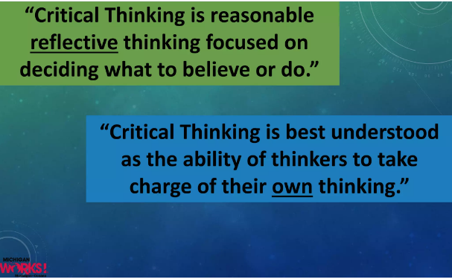
Attempts at Defining the act of Critical Thinking

Slide 12
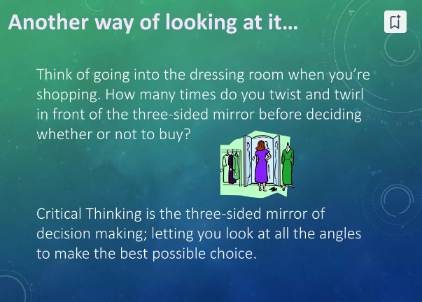

Slide 13
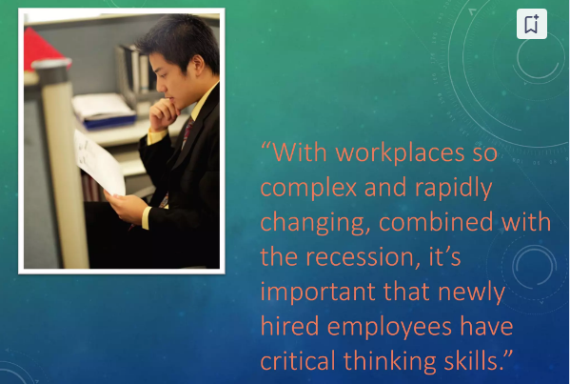

Slide 14
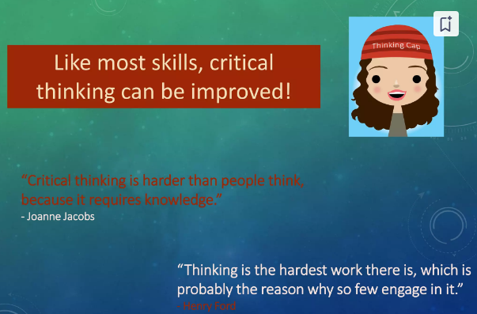

Slide 15
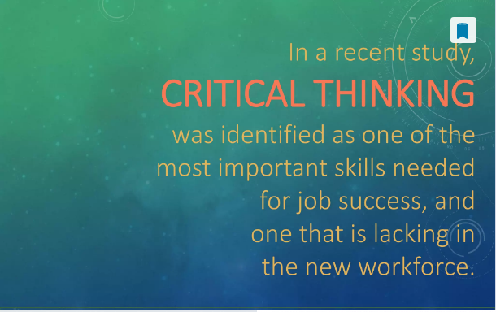
Some basic facts about critical thinking and Problem Solving Skills…

Slide 16
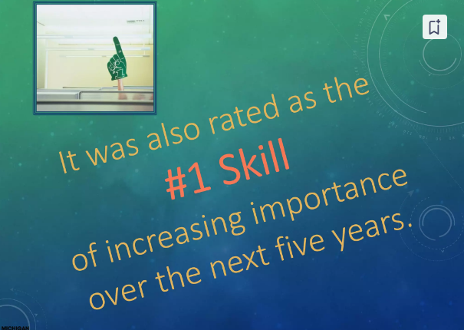
More Facts about Critical Thinking and Problem Solving Skills

Slide 17
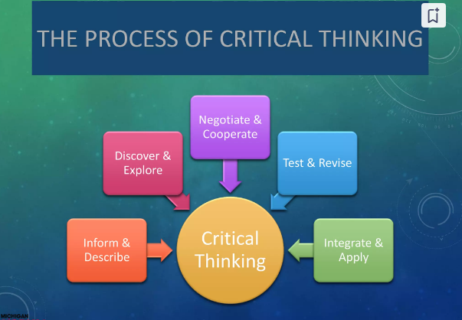

Slide 18
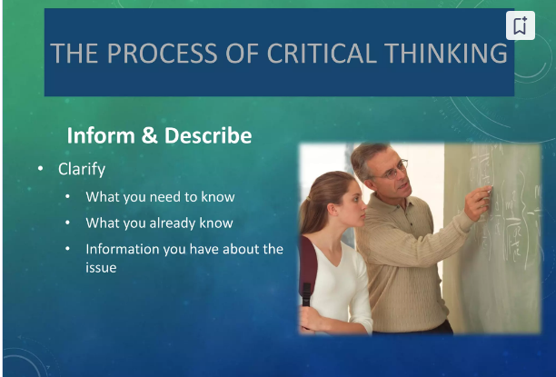

Slide 19
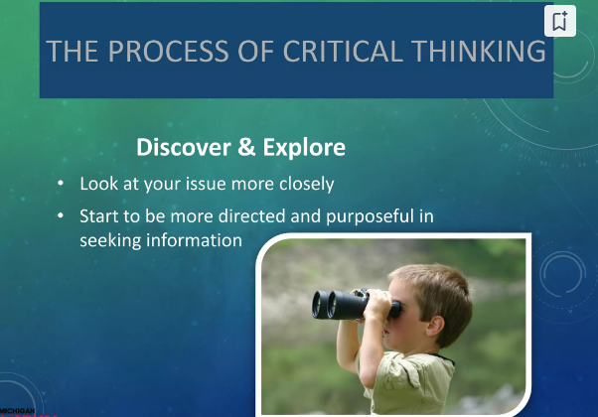

Slide 20
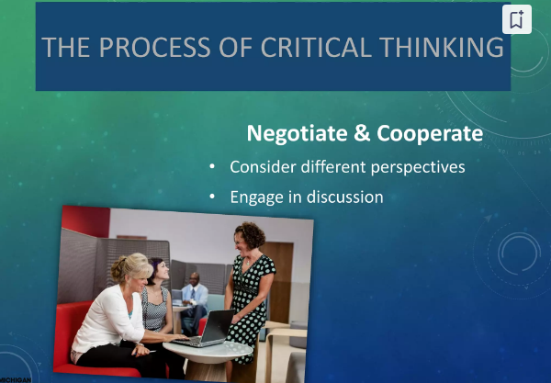

Slide 21
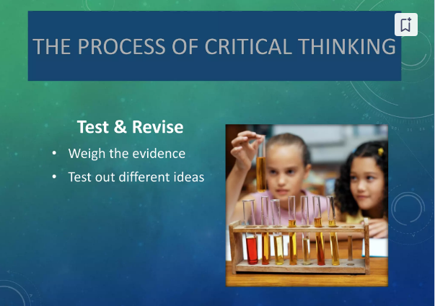

Slide 22
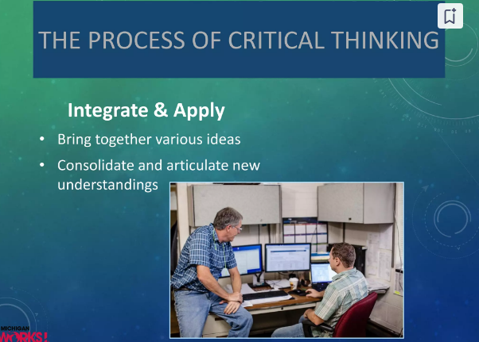

Slide 23
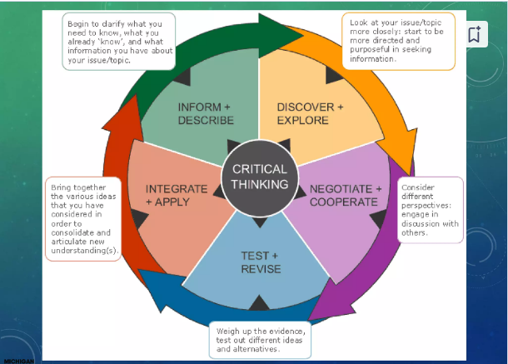

Slide 24
Basic Critical Thinking Skills…
When someone including ourselves is taking a position on an issue, what that issue is, and what the person is claiming relative to that issue- that is what the person’s position is.
What considerations are relevant to that issue?
Whether the reasoning underlying the person’s claims is good reasoning or not.
And whether, everything considered, we should accept, reject or suspend judgments on what the person claimed. Finally,
Doing all these requires us to be level headed and objective and not influenced by extraneous factors..

Slide 25
Other Basic Steps To Take: Understanding Factual Issues Versus None Factual Issues,
What Are issues?
Identifying Issues.
Factual Issues Versus None Factual Issues
Keeping a Clear Head

Slide 26
LET’S SEE HOW MUCH THINKING YOU CAN NOW MUSTER!
Take 1,000 add 40, add another 1,000, add 30, add 1,000 again. Plus 20. Plus 1,000 and plus 10. What is the total?
Miriam’s father has five daughters:
Cha Cha
Che Che
Chi Chi
Cho Cho
? ?

Slide 27
Critical Thinking And Clear Writing Skills
To be able to write clearly as a student, you will need to be acquainted with two factors:
ORGANIZATION &
FOCUS

Slide 28
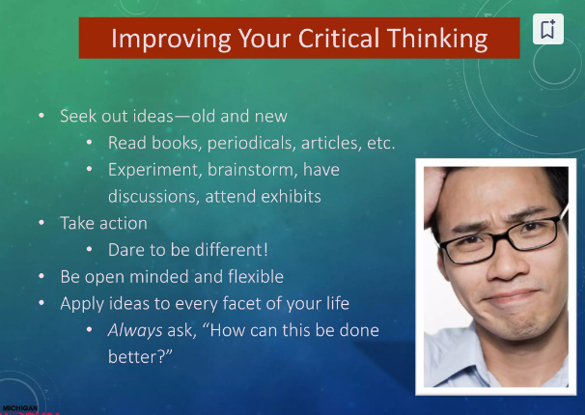

Slide 29
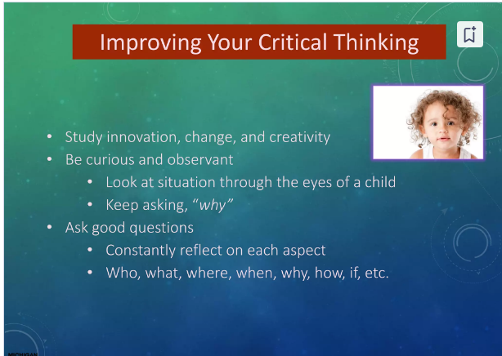

Slide 30
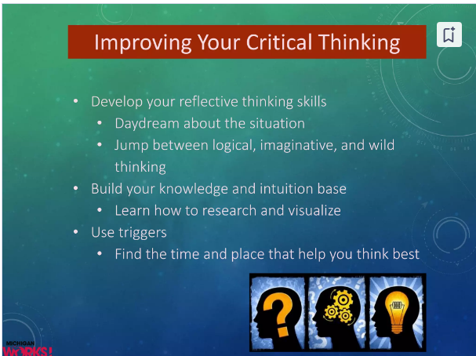

Slide 31
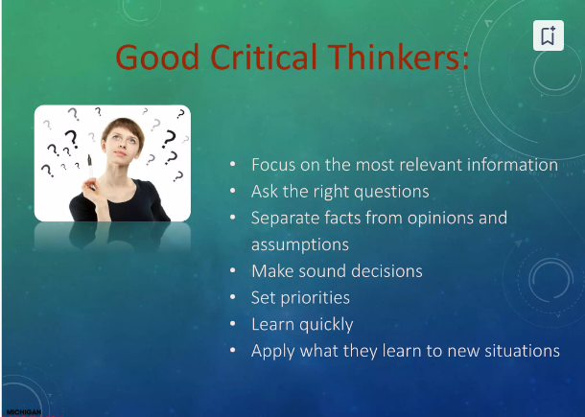

Slide 32
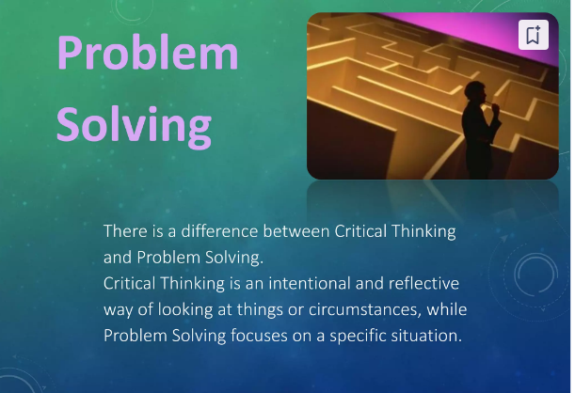

Slide 33
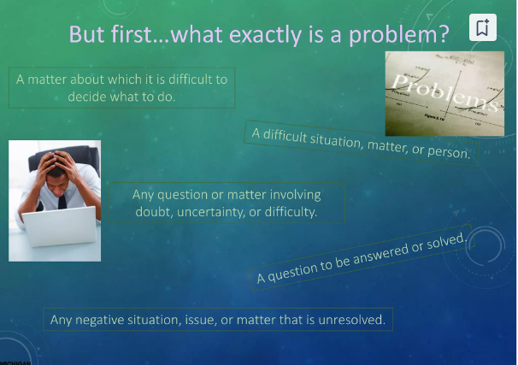

Slide 34
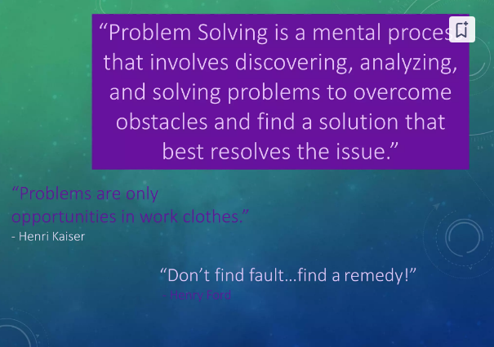

Slide 35
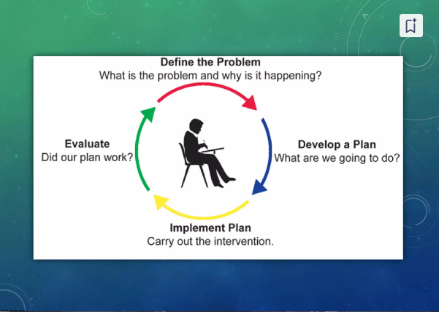
What
To
Do
About
Problems

Slide 36
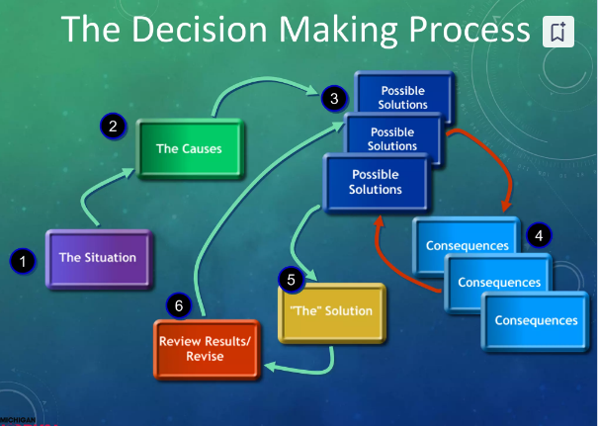

Slide 37
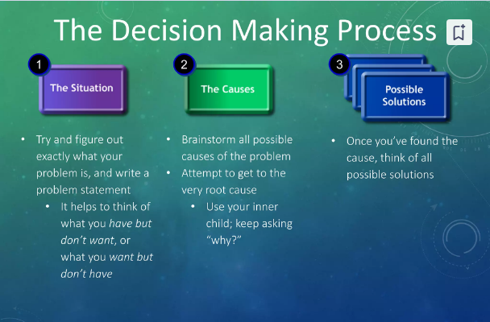

Slide 38
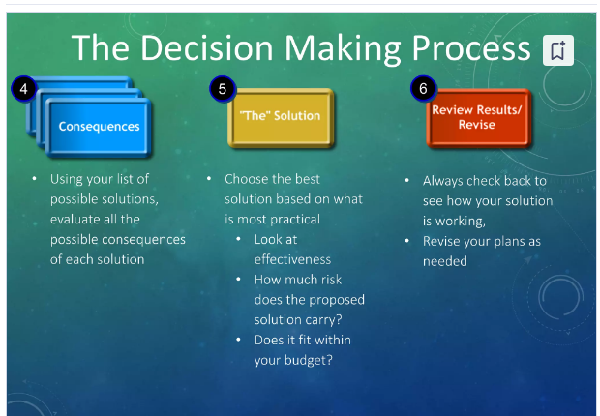

Slide 39
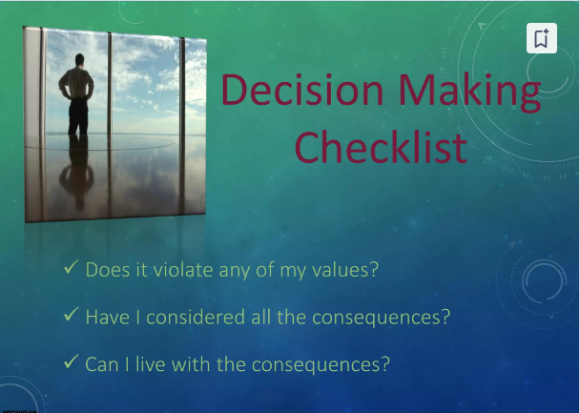

Slide 40
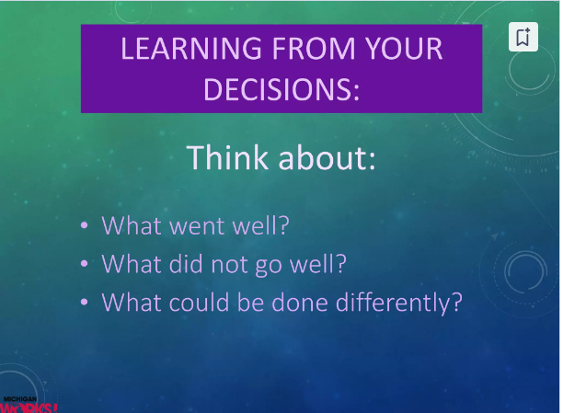

Slide 41

Hard Facts about most of the Decisions we
Make Daily…

Slide 42
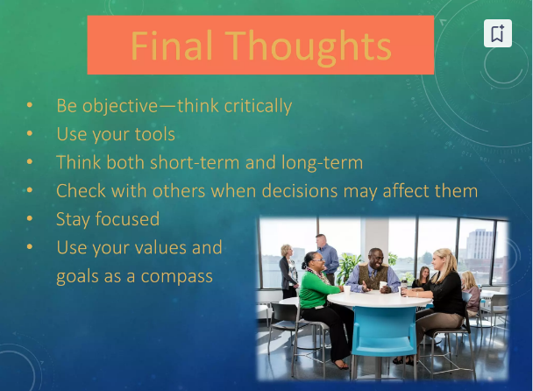

Slide 43
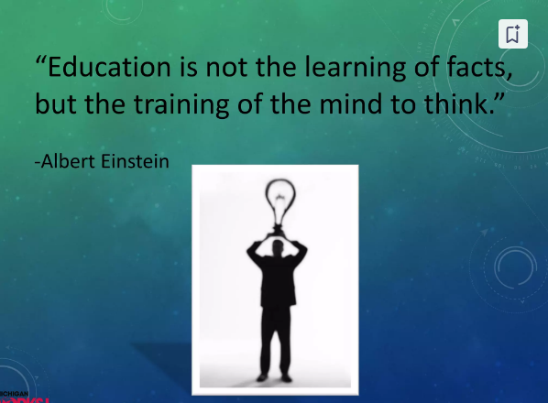

Slide 44
