Slide 1
Facing & Fighting Your Fears via Critical Thinking Skills…
AUN 300 Class BY WOGU, i. a. Power (PhD)
American University of Nigeria.

Slide 2
THE SPARK FOR SCIENCE
“I shall let the little I have learnt go forth into the day in order that someone better than I may guess the truth, and in this work may prove and rebuke my error. At this I shall rejoice that I was yet a cause whereby such truth has come to light”.
ALBERCHT DURER

Slide 3
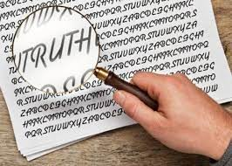
The Fact About The Essence & The Meaning of Truth..
Truth is sought for its own sake. And those who are engaged upon the quest for anything for its own sake are not interested in other things.
Finding the truth is difficult, and the road to it is rough. Alhazen (Ibn Al-Haytham)
Critique of Ptolemy

Slide 4
SOME FACT ABOUT THE NATURE OF TRUTH
It follows, therefore, that truth manifest itself… BENEDICT DE SPINOZA

Slide 5
What the Knowledge Critical Thinning Can Do By the Grace of God
Every man carries with him a touch stone … to distinguish truth from appearance.
JOHN LOCKE

